Slide 1

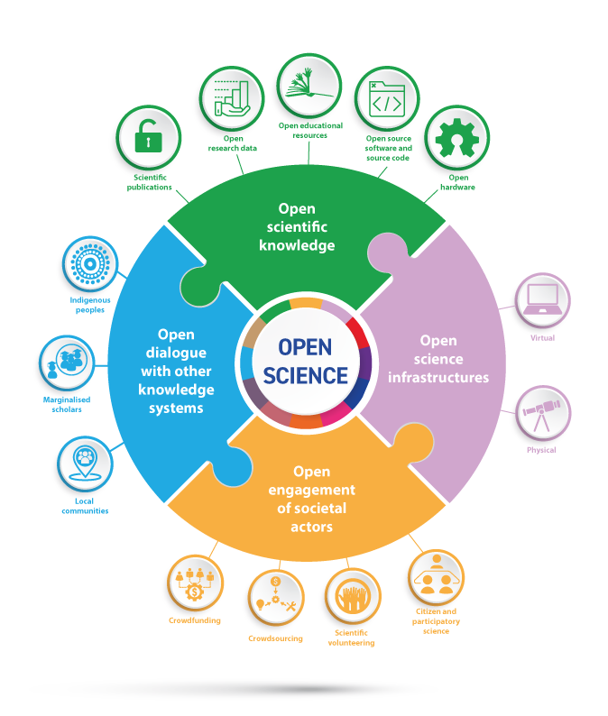

Adrien Fillon
08/04/2024
Should we be wary of open science?
Belgian Association for Psychological Sciences
University of Cyprus

Slide 2
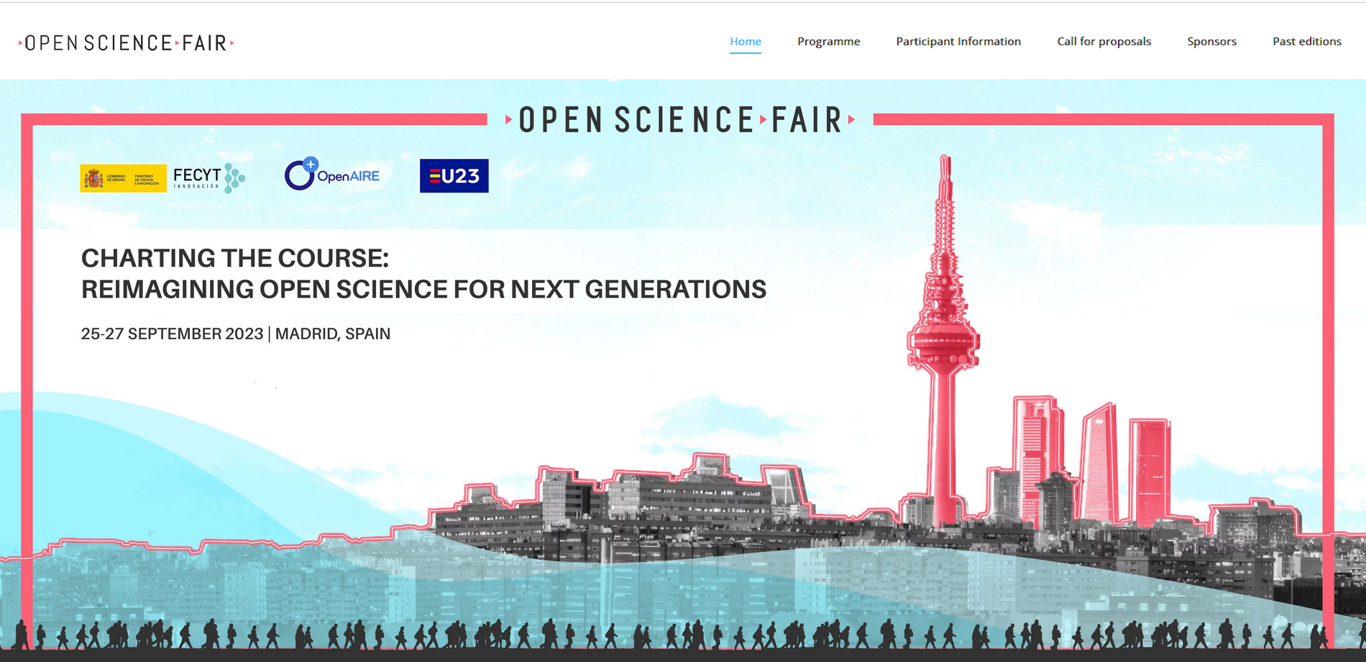
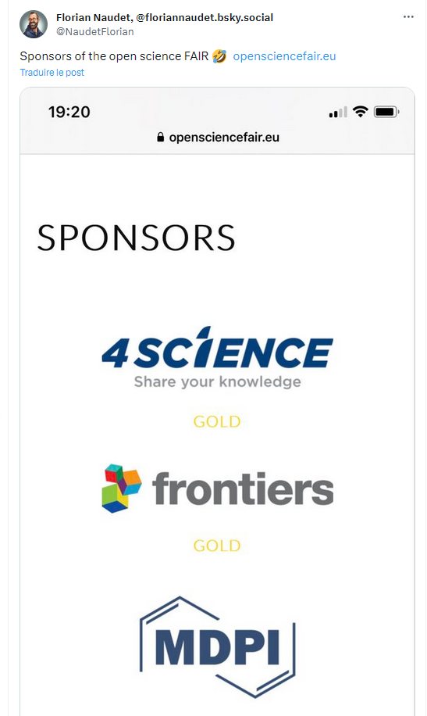
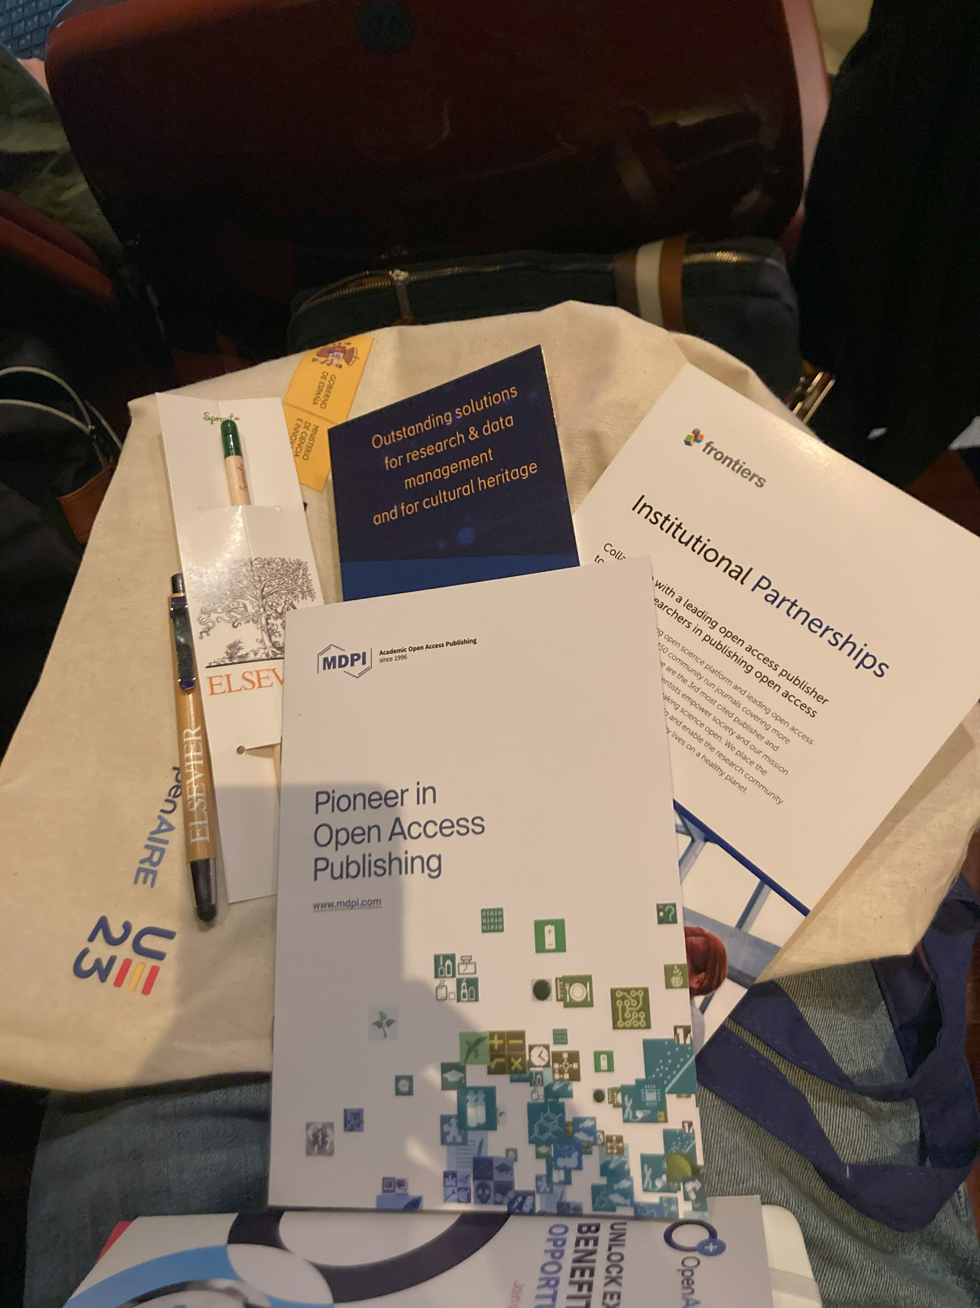

Slide 3
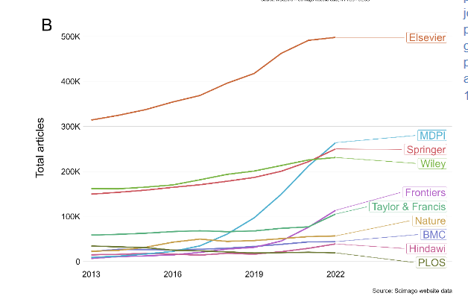
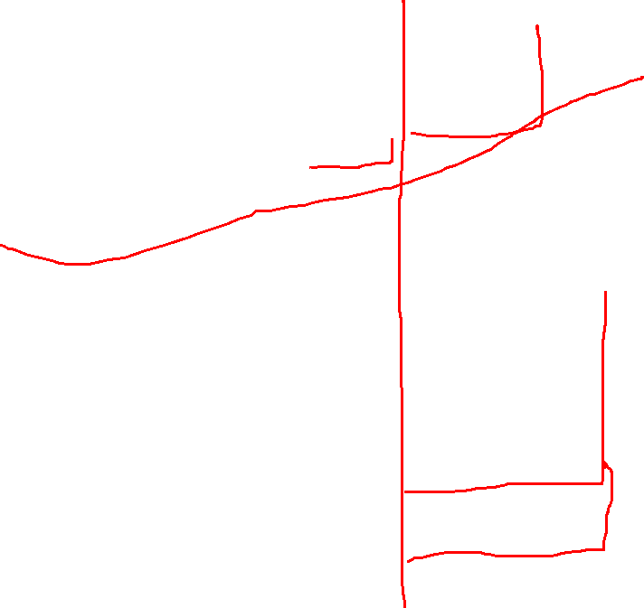
+1080%
+675%
In 3 Years
Hanson, M. A., Barreiro, P. G., Crosetto, P., & Brockington, D. (2023). The strain on scientific publishing (arXiv:2309.15884). arXiv. https://doi.org/10.48550/arXiv.2309.15884

Slide 4
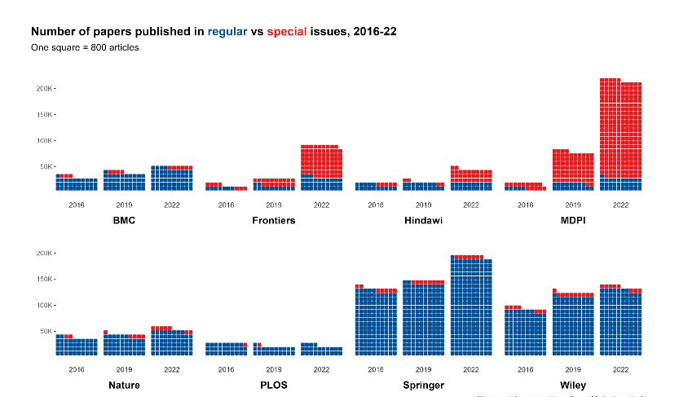
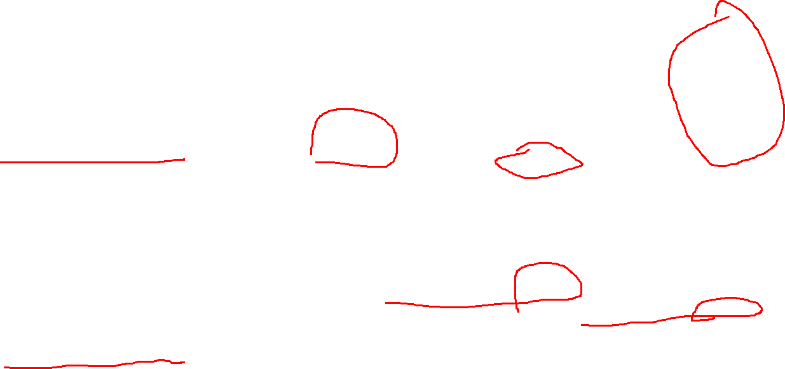
Hanson, M. A., Barreiro, P. G., Crosetto, P., & Brockington, D. (2023). The strain on scientific publishing (arXiv:2309.15884). arXiv. https://doi.org/10.48550/arXiv.2309.15884

Slide 5
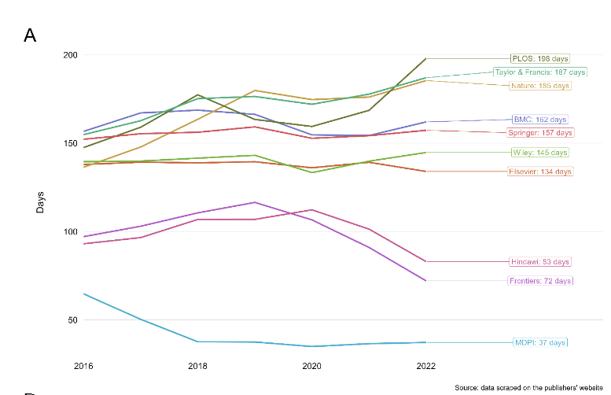
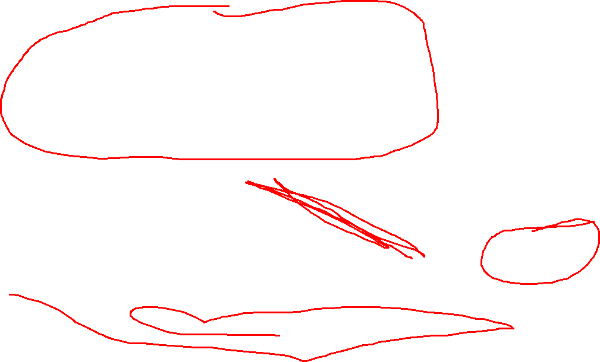
Hanson, M. A., Barreiro, P. G., Crosetto, P., & Brockington, D. (2023). The strain on scientific publishing (arXiv:2309.15884). arXiv. https://doi.org/10.48550/arXiv.2309.15884

Slide 6
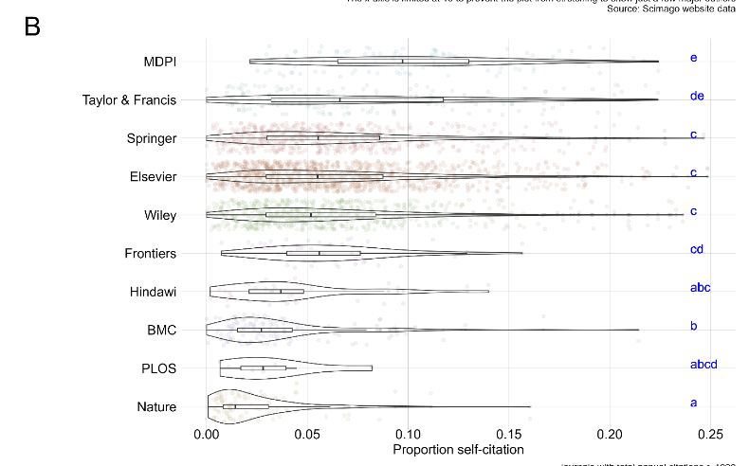
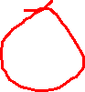
Hanson, M. A., Barreiro, P. G., Crosetto, P., & Brockington, D. (2023). The strain on scientific publishing (arXiv:2309.15884). arXiv. https://doi.org/10.48550/arXiv.2309.15884

Slide 7
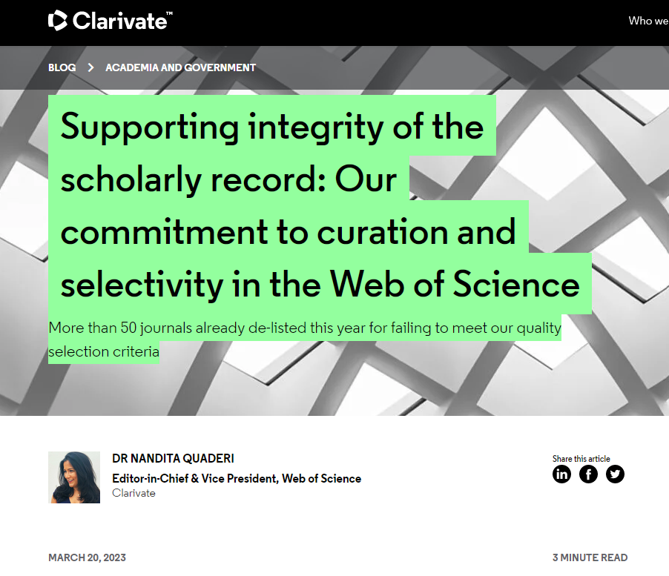
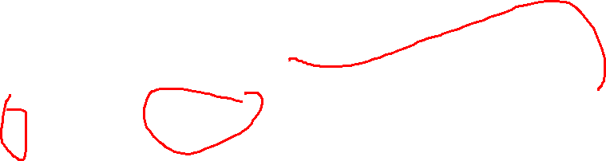
Notes:
Clarivate = web of science
+ 50 journaux délistés majoritairement de MDPI mais aussi de frontiers ou Hindawi publié par Wiley.

Slide 8
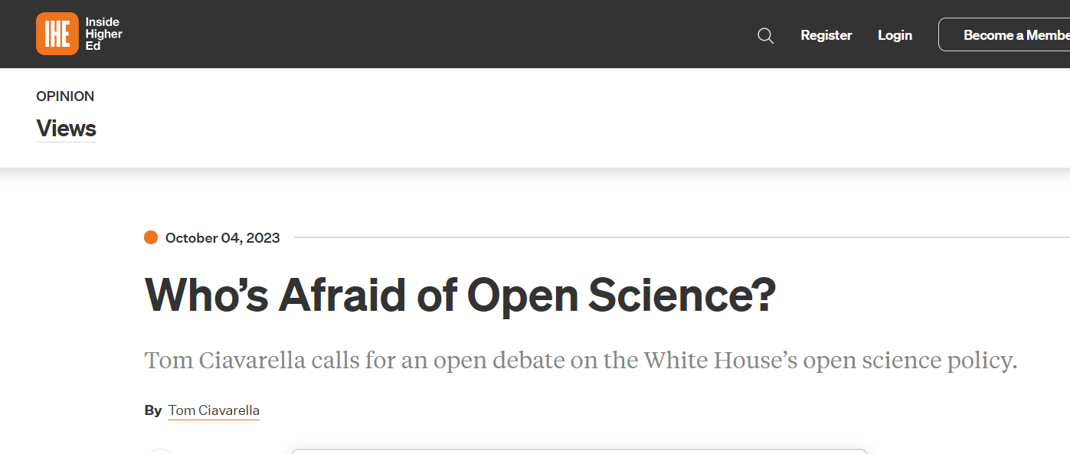

Slide 9
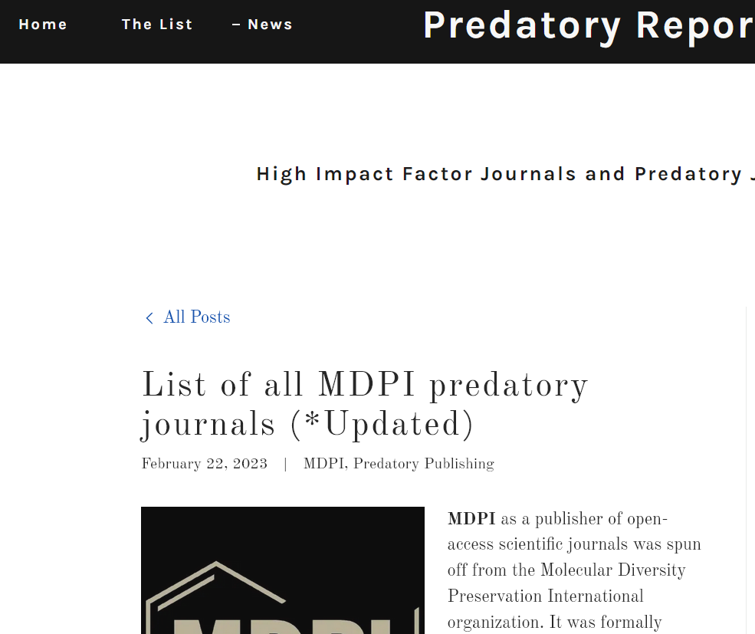

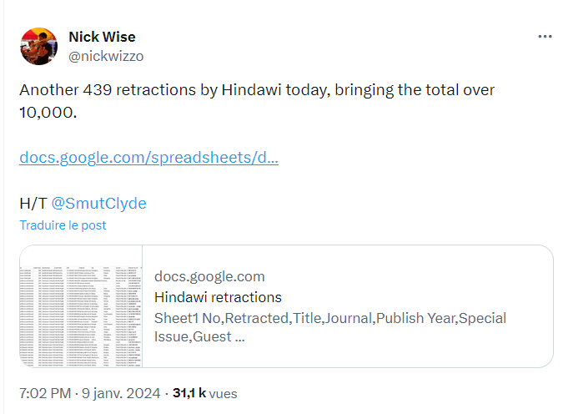
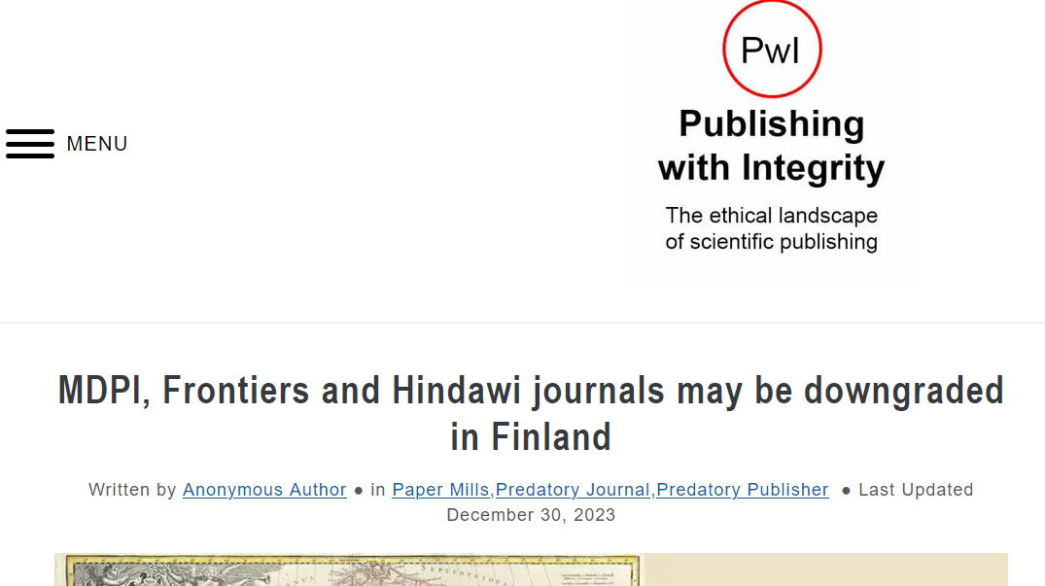

Slide 10
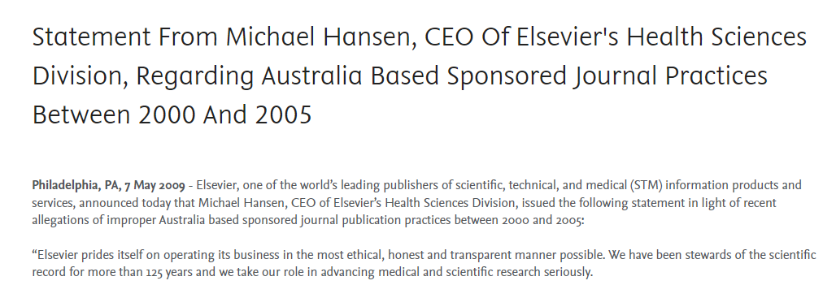
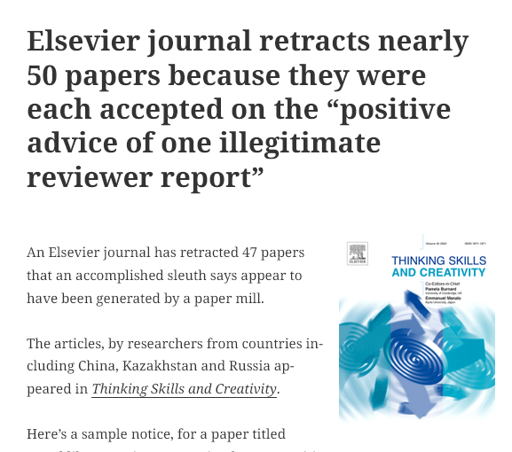

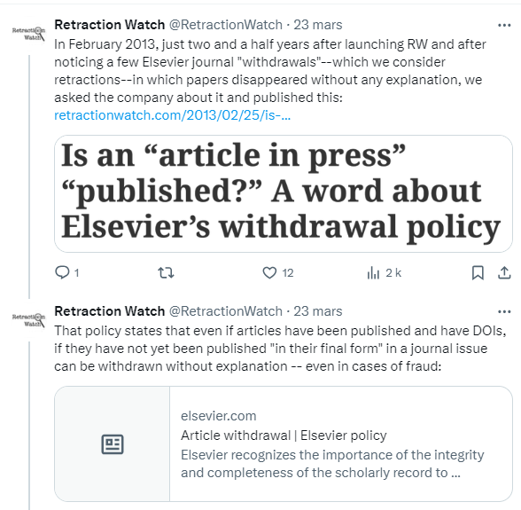
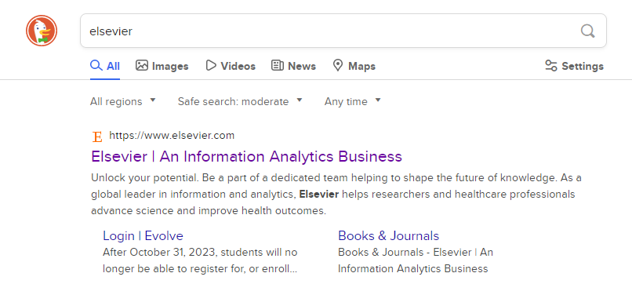
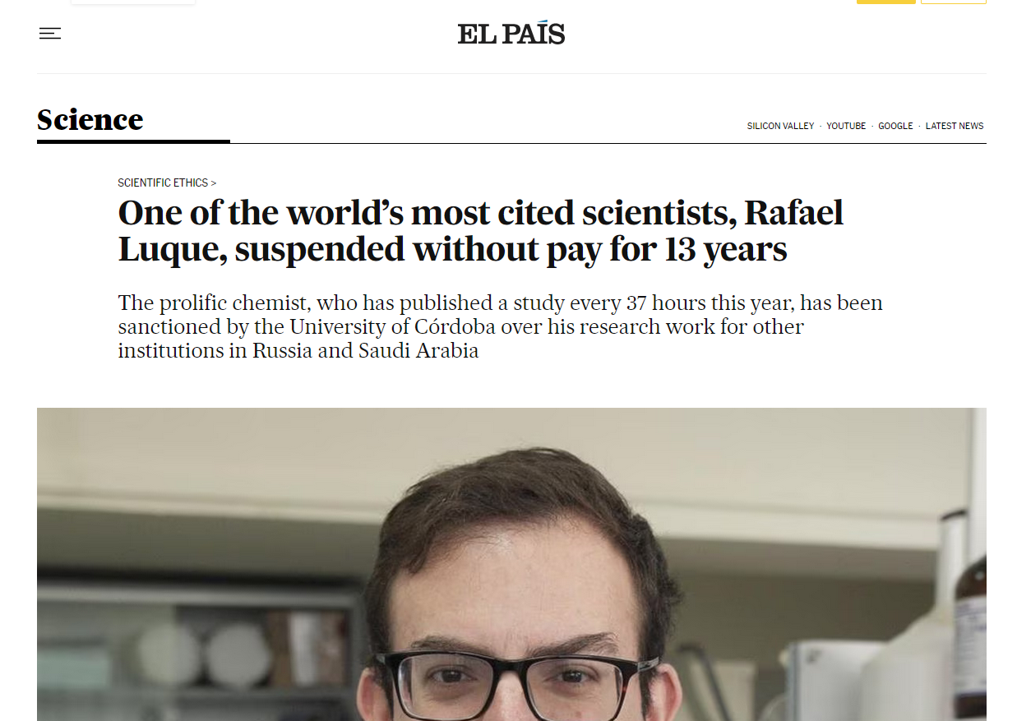
Sponsored articles
Paper Mill
Incredible publication rate
Notes:
Et je vais vous prouver que Elsevier n’est définitivement pas un éditeur scientifique.

Slide 11
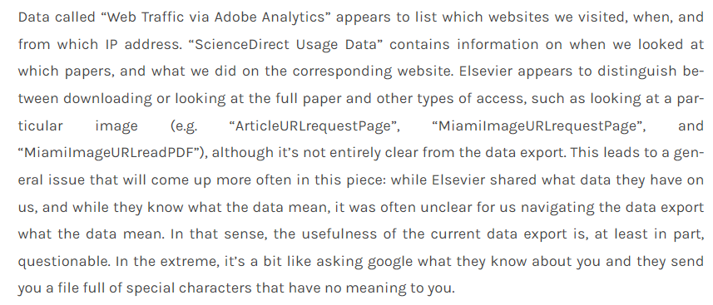
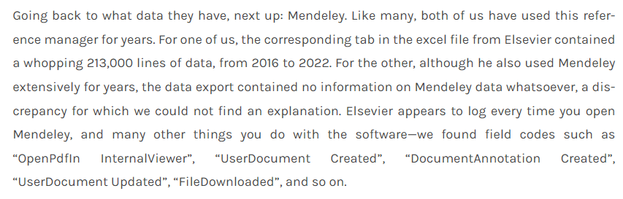
Elsevier Knows everything about you
Fried, E. (2022). Welcome to Hotel Elsevier: You can check-out any time you like … not ». Eiko-Fried. https://eiko-fried.com/welcome-to-hotel-elsevier-you-can-check-out-any-time-you-like-not/

Slide 12
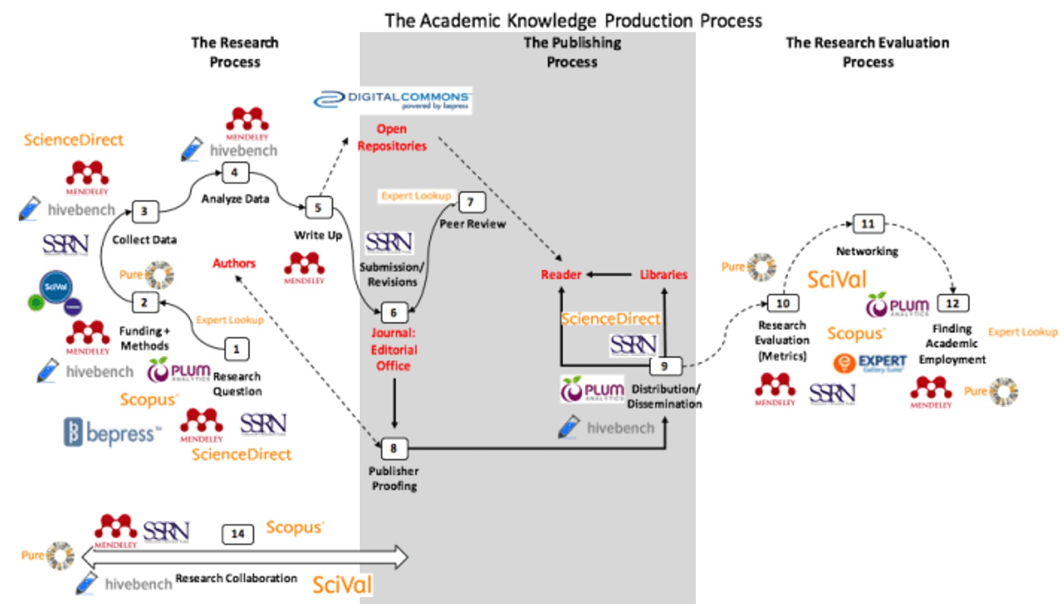
Brembs, Björn. (2021). Algorithmic employment decisions in academia? Bjoern.Brembs.Blog. https://bjoern.brembs.net/2021/09/algorithmic-employment-decisions-in-academia/
Notes:
Ils controllent l’ensemble du système académique

Slide 13
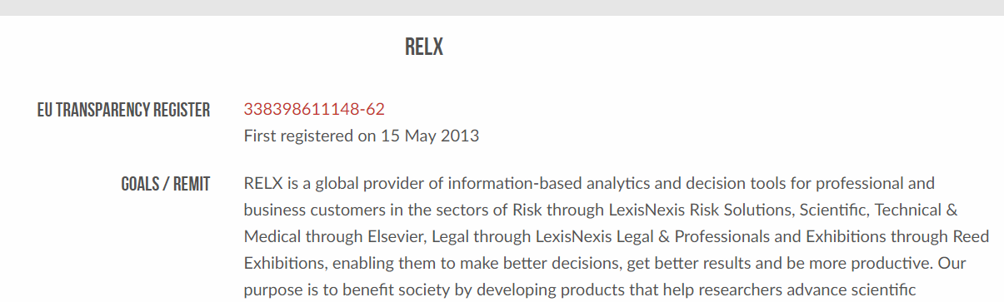
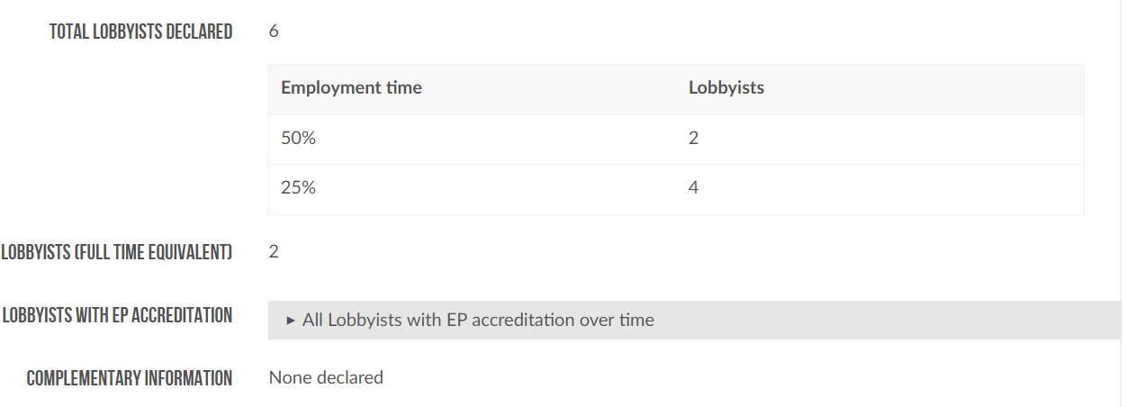
LobbyFacts.eu. (2023). RELX. Consulted October 12, 2023, at https://www.lobbyfacts.eu/datacard/relx?rid=338398611148-62

Slide 14
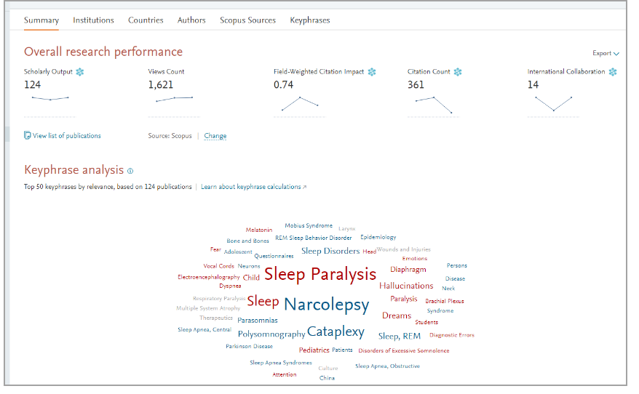
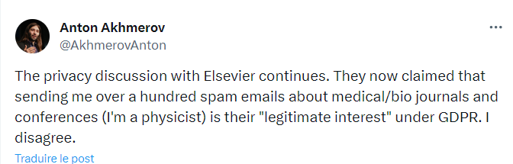
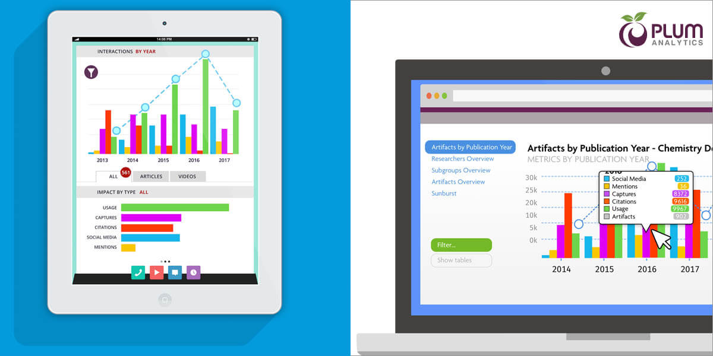
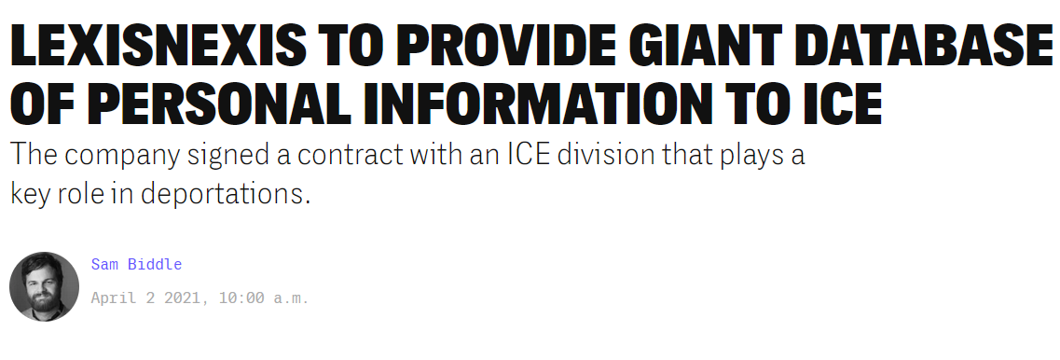
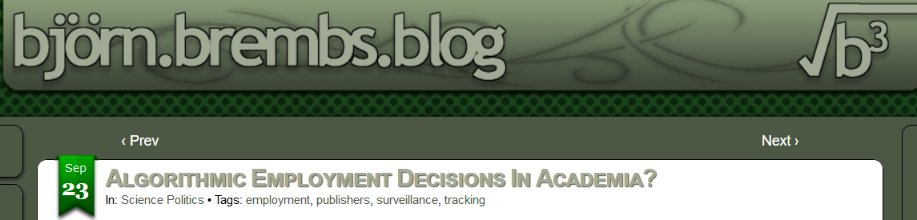
What does Elsevier do with these data ?
Mail Spam
Direct data selling
Decision Automatization

Slide 15
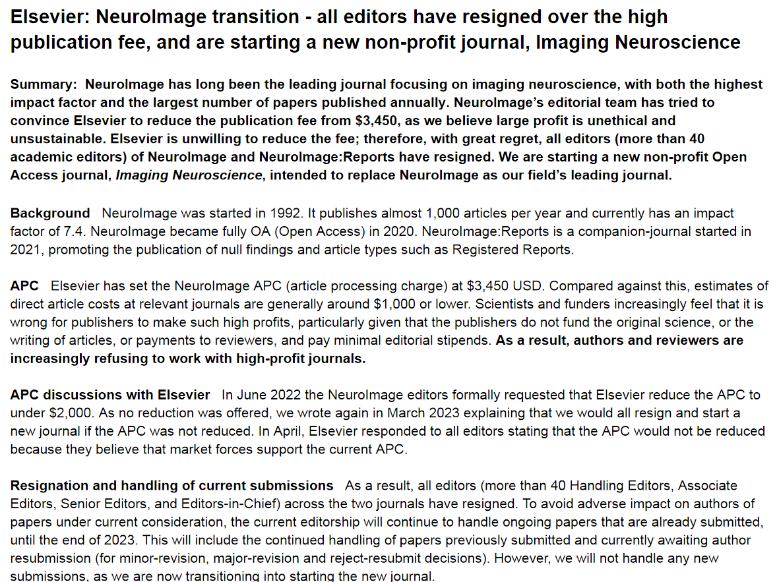

Slide 16
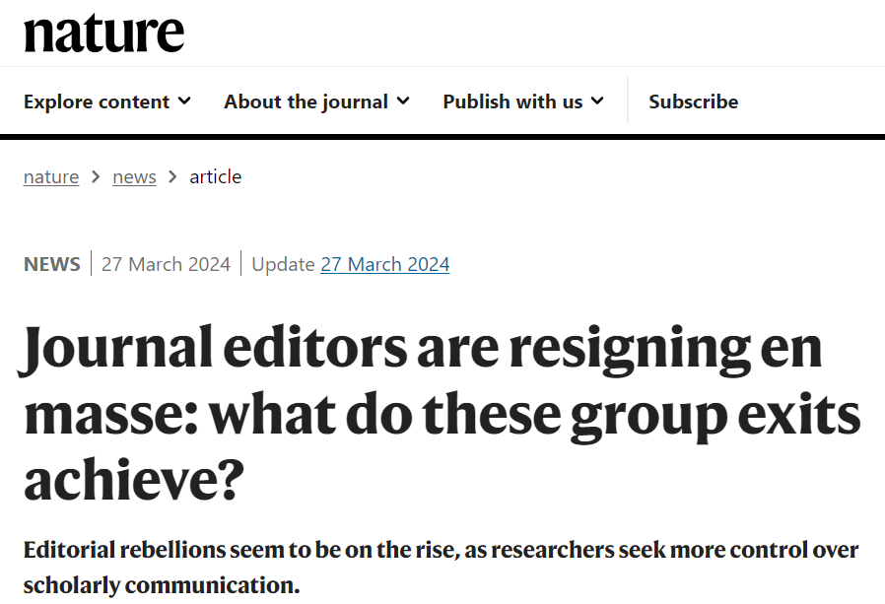
Resignation
NeuroImage – March 2023
“It wasn’t that we were opposed to the principle of open access,” she says. Instead, the editors were deeply opposed to the article-processing-charge model, in which authors are charged fees to publish their papers open access. The team decided to resign only after a year of discussions with the publisher about alternative models failed to produce a compromise”
Critical Public Health – July 2023
BMC Pregnancy and Childbirth – February 2024
BMC Women’s Health – February 2024
Syntax – March 2024

Slide 17
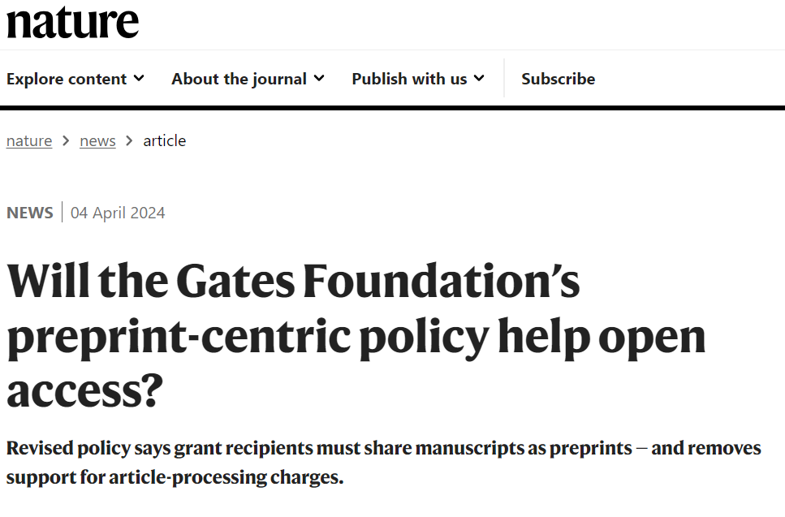
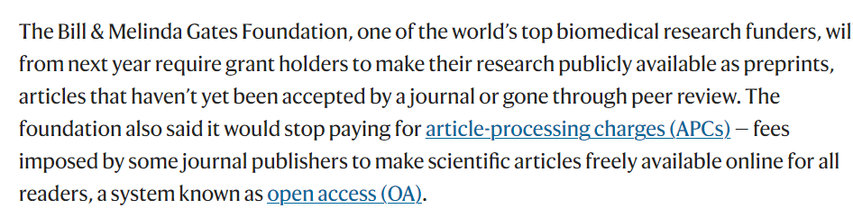

Slide 18
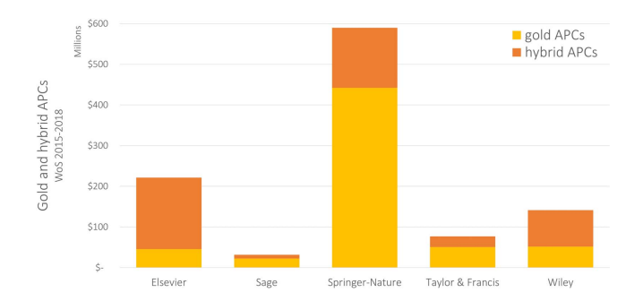
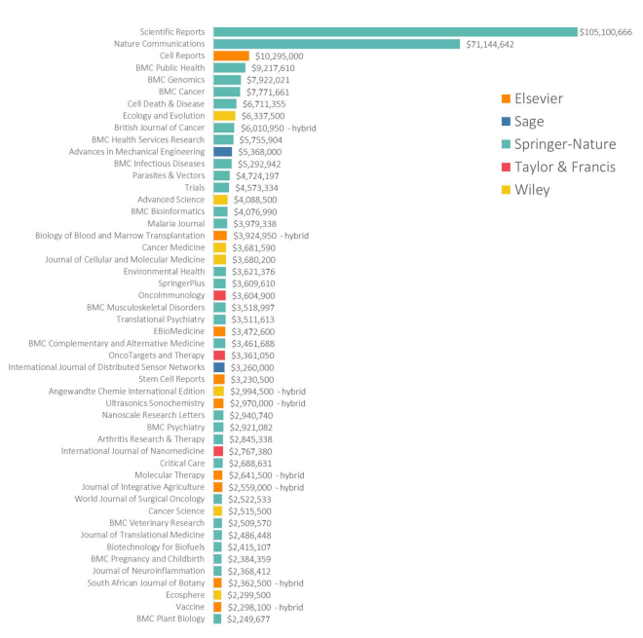
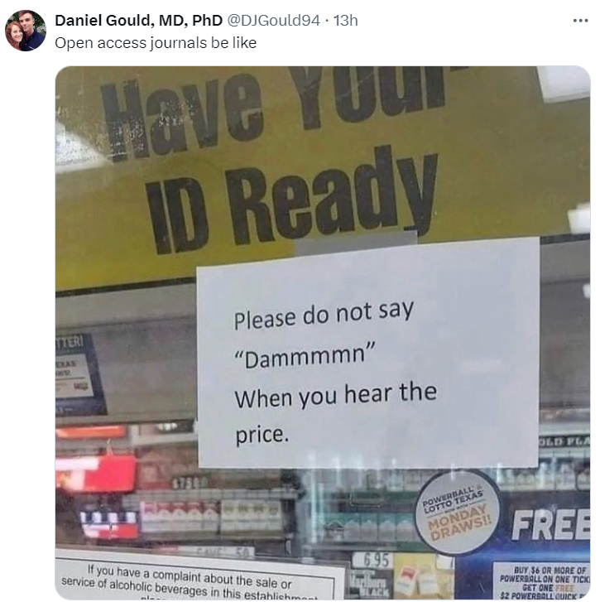
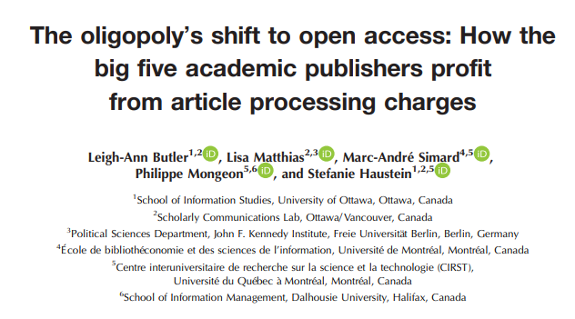

Slide 20
PART 1 CONCLUSION
All publishers are predatory, their own way
It’s terribly hard to correct science, mostly because of publishers' unwillingness to protect publication process from bad papers and correctly withdraw papers
The publishing market is broken, as there is an oligopoly by 5 publishers, one far too big to fail
Publishers gets a lot of money from APCs (more than 1,06 billion before the 2019 exponential), and don’t care about the editing process leading to en-masse resignations
Publishers love Open Science, but mostly because they benefits from APCs and data selling (directly or indirectly)

Slide 21
Should we be wary of open science?

Slide 22
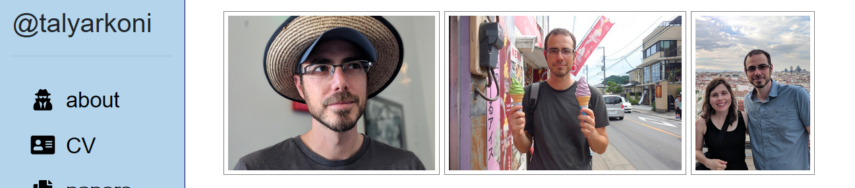
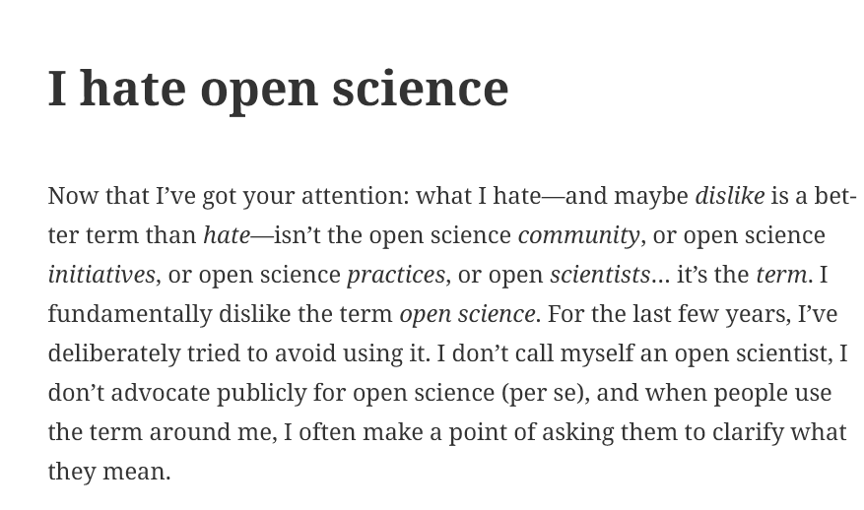

Accessibility
Incentive Alignment
Openness of opinion
Diversity
Reproducibility
Meta-science
« Publishers »
Open Access
Open Data
Open Material

Slide 23

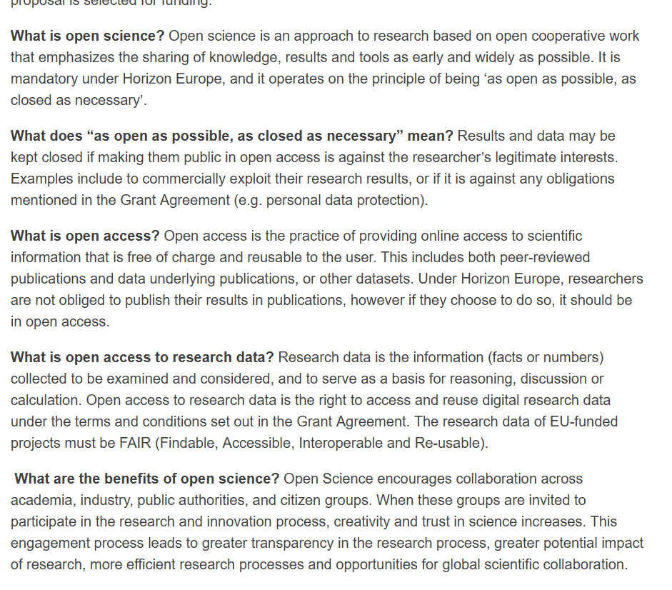
Only Publishers, Really?
Notes:
What is open science > what is open access
Open science EST l’open access pour eux

Slide 24
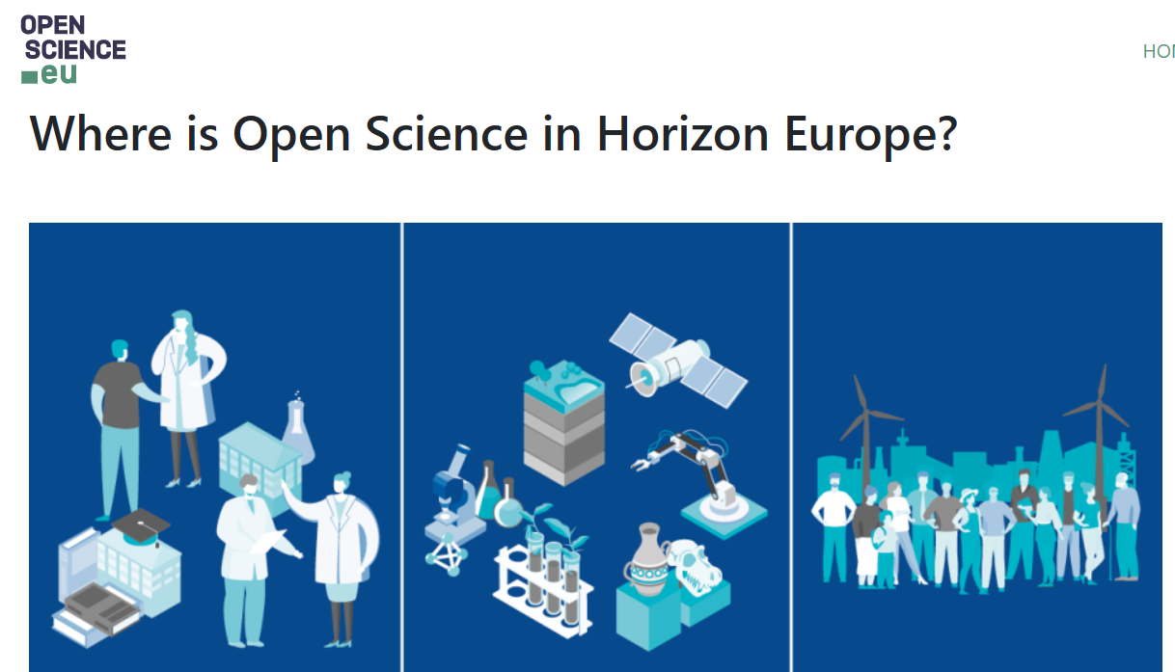
Only Publishers, Really?
Notes:
What is open science > what is open access
Open science EST l’open access pour eux

Slide 25

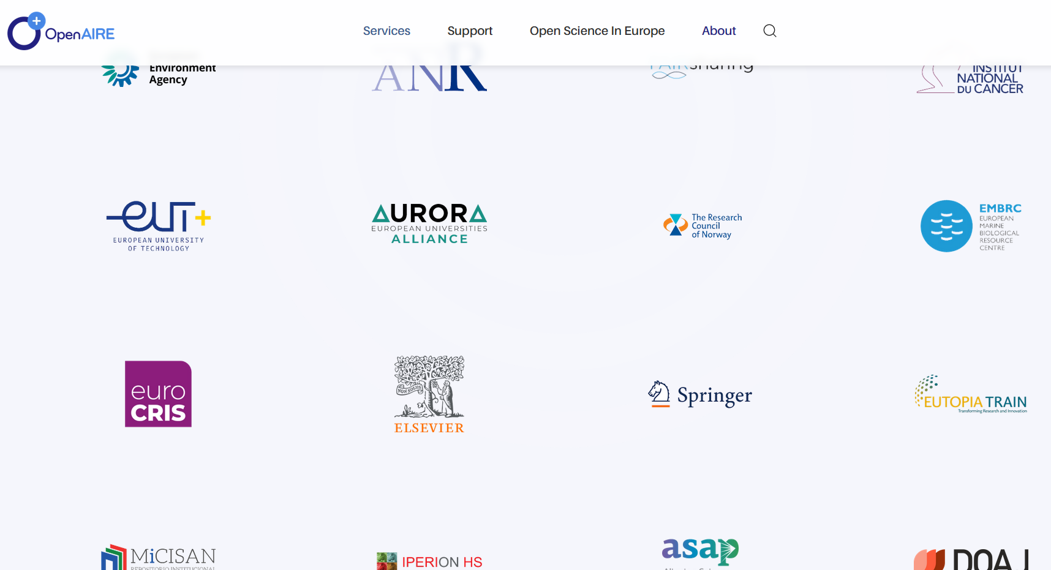
Only Publishers, Really?
Notes:
What is open science > what is open access
Open science EST l’open access pour eux

Slide 26
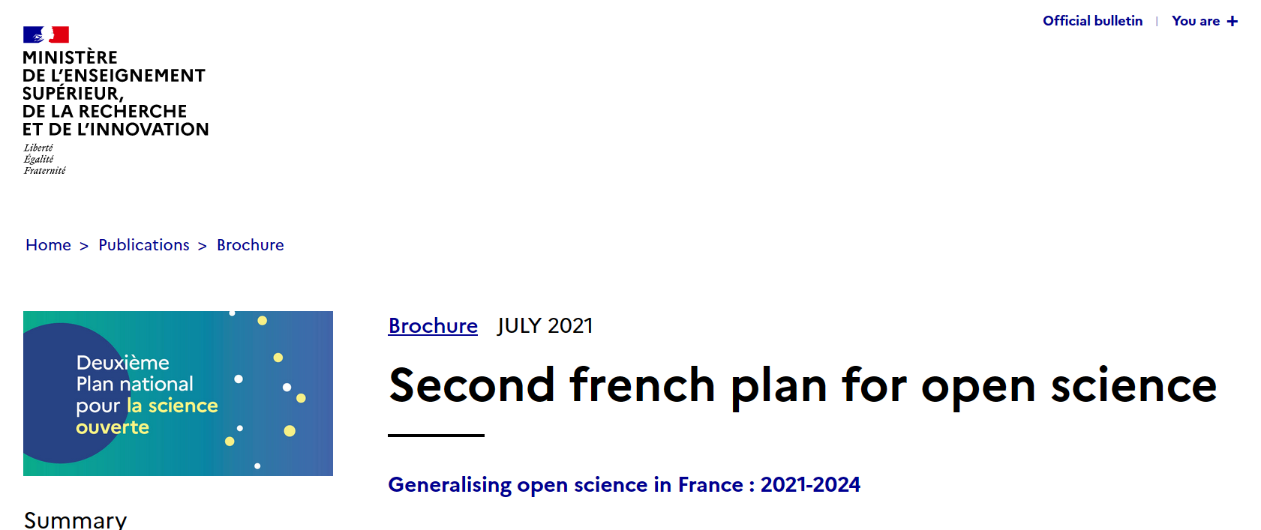
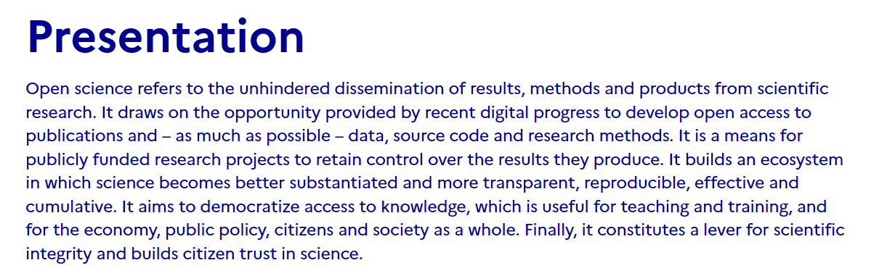
Only Publishers, Really?

Slide 27

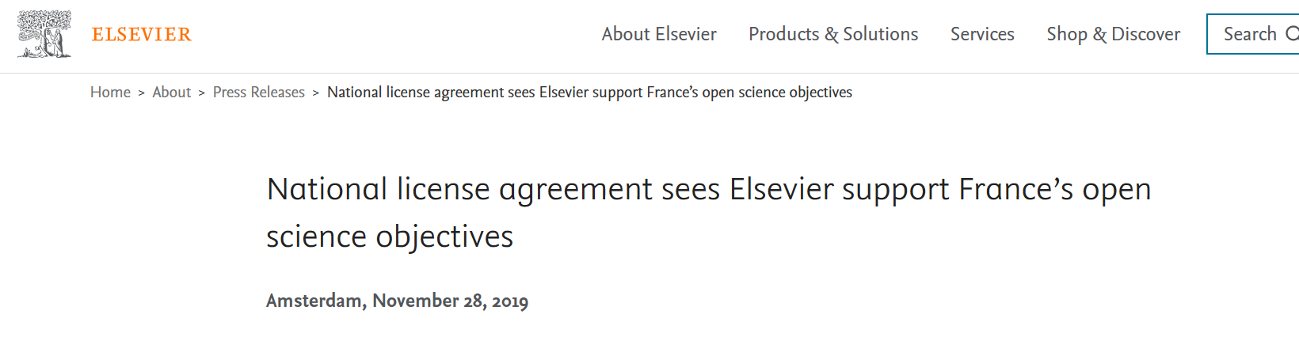
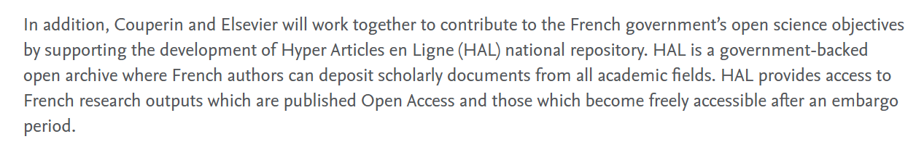
Only Publishers, Really?
Now more and more mandatory for french researchers

Slide 28
What is (not) Open Science?

Slide 29
What is (not) Open Science?
Definition
Open Science is not only Open Access
« Publishers »
Institutions
Projects, initiatives, conferences

Slide 30


What is (not) Open Science?
Definition
Open Science is not only Open Access
Open Science is transparency
AND quality control
Vazire, S., & Holcombe, A. O. (2022). Where Are the Self-Correcting Mechanisms in Science? Review of General Psychology, 26(2), 212223. https://doi.org/10.1177/10892680211033912

Slide 31

What is (not) Open Science?
Definition
Open Science is not only Open Access
Open Science is transparency
AND quality control
Open Science is not only a set of skills,
but also a culture
Vazire, S. (2018). Implications of the Credibility Revolution for Productivity, Creativity, and Progress. Perspectives on Psychological Science, 13(4), 411417. https://doi.org/10.1177/1745691617751884

Slide 32
What is Open Science?
Definition
Objectives
Open Science is not only
Open Access
Open science is not an objective, but a mean
Open Science is transparency
AND quality control
The objective is to increase quality of science
Open Science is not only
a set of skills,
but also a culture
Once Open Science will be current, the quality objective will remain
Open Science should be
normal science

Slide 33
What is Open Science?
Definition
Objectives
Beneficiaries
Open Science is not only
Open Access
Open science is not an objective, but a mean
Publishers should not be the main beneficiaries
Open Science is transparency
AND quality control
The objective is to increase quality of science
Citizens cannot be the main beneficiaries
Open Science is not only
a set of skills,
but also a culture
Once Open Science will be current, the quality objective will remain
Beneficiaries should be researchers
Open science needs to take their needs into account
Open Science should be
normal science

Slide 34






Open science needs to take their needs into account

Slide 35
What is Open Science?
Definition
Objectives
Beneficiaries
Publishers should not be the main beneficiaries
Open Science is not only
Open Access
Open science is not an objective, but a mean
Open Science is transparency
AND quality control
The objective is to increase quality of science
Citizens cannot be main beneficiaries
Open Science is not only
a set of skills,
but also a culture
Once Open Science will be current, the quality objective will remain
Beneficiaries should be researchers
Open science needs to take their needs into account
Open Science should be
normal science

Slide 36
Should we be wary of open science?
YES
Be careful about who defined it and how
Be careful about who benefits from it
Use this doubt to improve the culture and researcher’s organization
to produce a better quality science

Slide 37

Fillon, A. A., MANIADIS, Z., Méndez, E., & Sánchez-Núñez, P. (2024, April 5). Should we be wary of the role of scientific publishers in Open Science?. https://doi.org/10.31234/osf.io/rxv94

